Slide 1
Final exam project
20182557 김경영
20182582 진우태

Slide 2
목차
Arduino
Visual Studio
Mongo

Slide 3
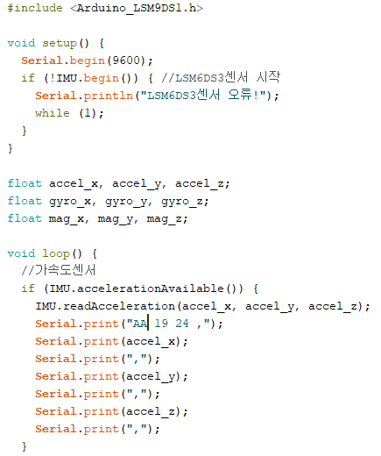
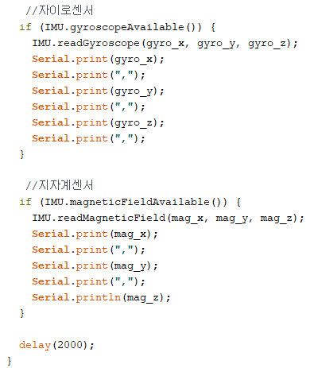
Arduino Code

Slide 4
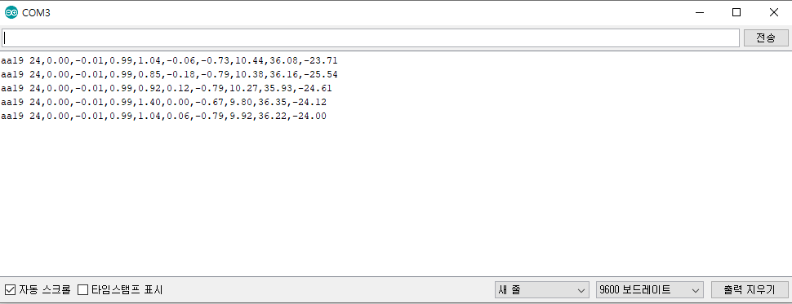
Arduino SerialMonitor

Slide 5
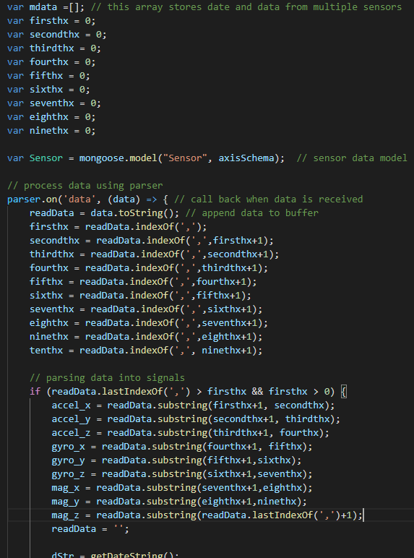
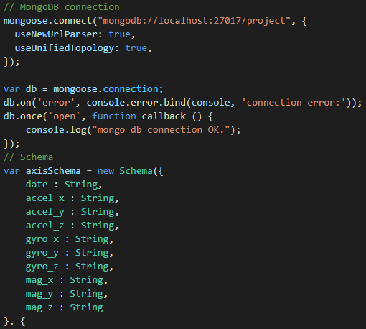
Visual Studio (node) code

Slide 6
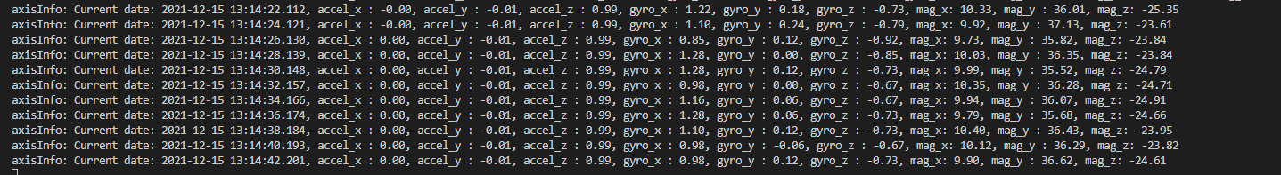
Visual Studio (node)

Slide 7
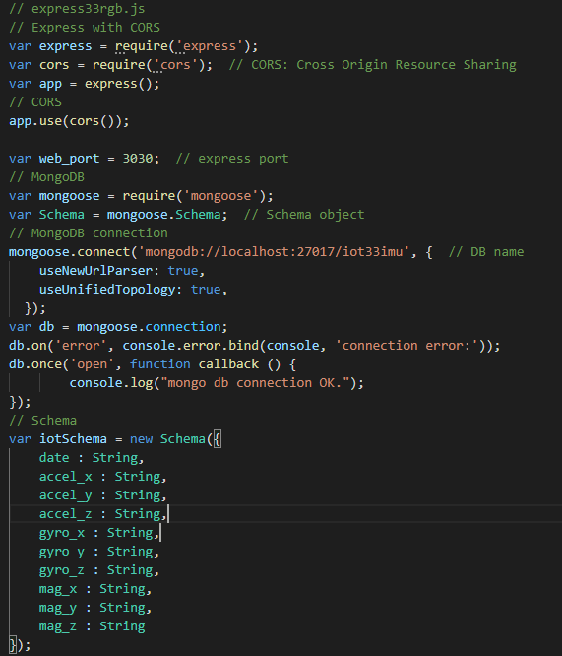
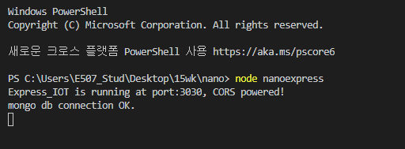
Visual Studio (Express)

Slide 8
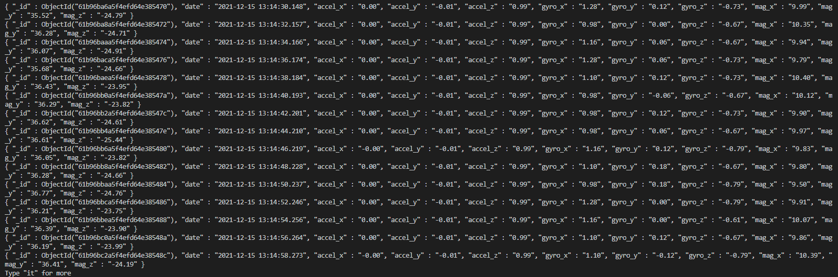
Mongo

Slide 9
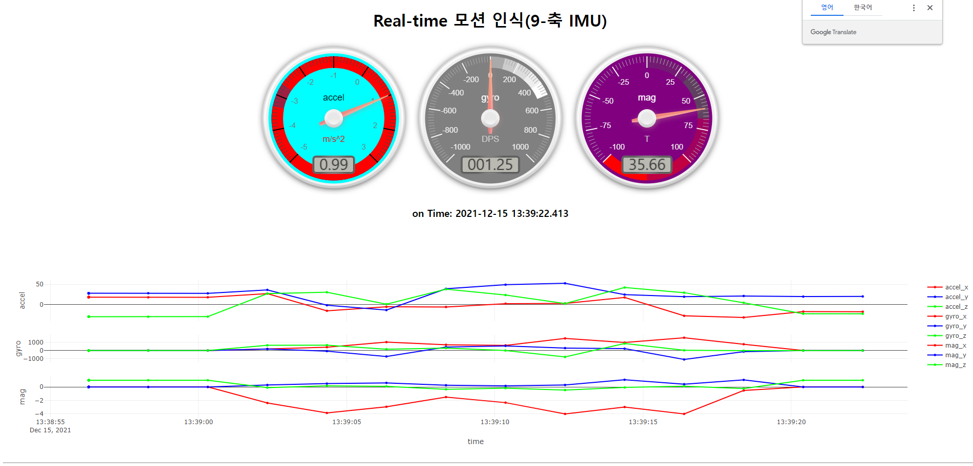
HTML

Slide 10
감사합니다.

